Slide 1
Optical Character Recognition

Slide 2
Overview
Objective
Data
Techniques used for project
Demonstration
Results

Slide 3
OCR
The goal of Optical Character Recognition (OCR) is to classify optical patterns (often contained in a digital image) corresponding to alphanumeric or other characters.
The process involves several steps including segmentation, feature extraction, and classification.

Slide 4
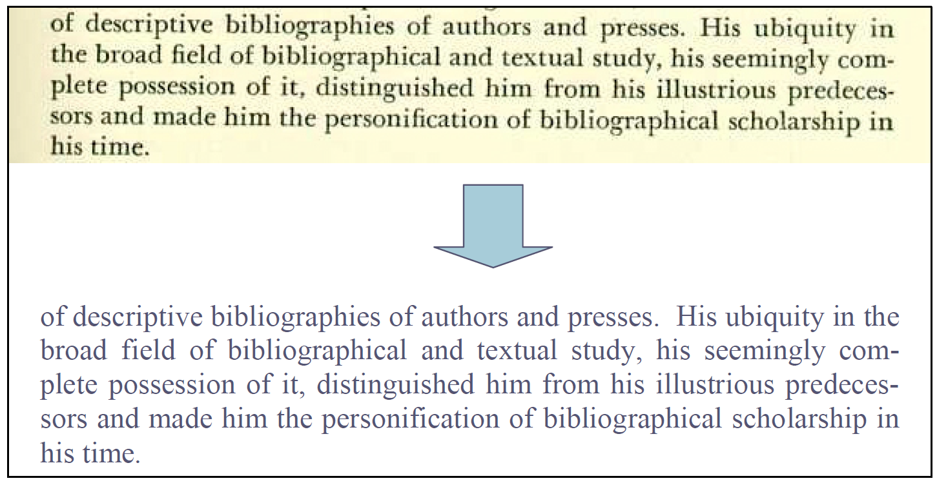
Applications of OCR
1. Convert text documents to some sort of digital representation.
2. Scan a document and have the text available in a word processor.
3. Recognizing license plate numbers
4. Post Office needs to recognize zip-codes and many more applications..

Slide 5
Data
We used 74k dataset which is very popular dataset for OCR research
We limited the character set to English language and Hindu-Arabic numerals. So the dataset consists of:
64 classes (0-9, A-Z, a-z)
7705 characters obtained from natural images
3410 hand drawn characters using a tablet PC
62992 synthesised characters from computer fonts
This gives a total of over 74K images (which explains the name of the dataset).

Slide 6


Dimenionality reduction and Pre processing the data
The original images in training dataset are large in terms size.
A Python parser is used to preprocess them which includes converting them to grey scale, remove background noise and reducing the size to (32*32)
1.28 KB(900*1200) 0.21 KB(32*32)
After processing the images, the size of training dataset was 7705*1024 with 7705 images to train.
🔨

Slide 7
Objective
Steps involved in training the model
Dimension reduction and Pre-processing using PCA
Feature extraction – Reduce the amount of data by extracting relevant information—Usually results in a vector of scalar values.
Model Estimation – from the finite set of feature vectors estimate the model for each class of the training data
Perform character and line segmentation

Slide 8
Results
KNN
 | A | B | C
Yellow | 10 | 20 | 7
Blue | 30 | 15 | 10
Orange | 5 | 24 | 16

Slide 9
Results
Decision Trees
 | A | B | C
Yellow | 10 | 20 | 7
Blue | 30 | 15 | 10
Orange | 5 | 24 | 16

Slide 10
Results
SVM
 | A | B | C
Yellow | 10 | 20 | 7
Blue | 30 | 15 | 10
Orange | 5 | 24 | 16

Slide 11
Thanks!
👍
Any questions?

